Slide 1
Homework 1

Slide 2
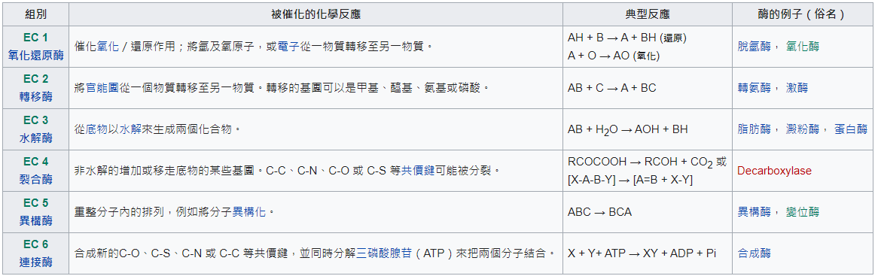
Enzyme Database
Enzymes are proteins that act as biological catalysts.
The Enzyme Commission number (EC number) is a numerical classification scheme for enzymes, based on the chemical reactions they catalyze. As a system of enzyme nomenclature, every EC number is associated with a recommended name for the respective enzyme.

Slide 3
Enzyme Database
Every enzyme code consists of the letters "EC" followed by four numbers separated by periods. Those numbers represent a progressively finer classification of the enzyme. Preliminary EC numbers exist and have an 'n' as part of the fourth (serial) digit (e.g. EC 3.5.1.n3).

Slide 4
Homework 1
請分析uniprot_sprot.dat (~db/uniprot_sprot.dat) 並建立Enzyme Database
欄位
UNI_ID (Primary Key) (ID)
AC (1~n) (AC)
不同AC用;分隔
EC (1~n) (DE)
不同EC用;分隔
PDB (0~n) (DR)
不同PDB用;分隔
Sequence (SQ)

Slide 5
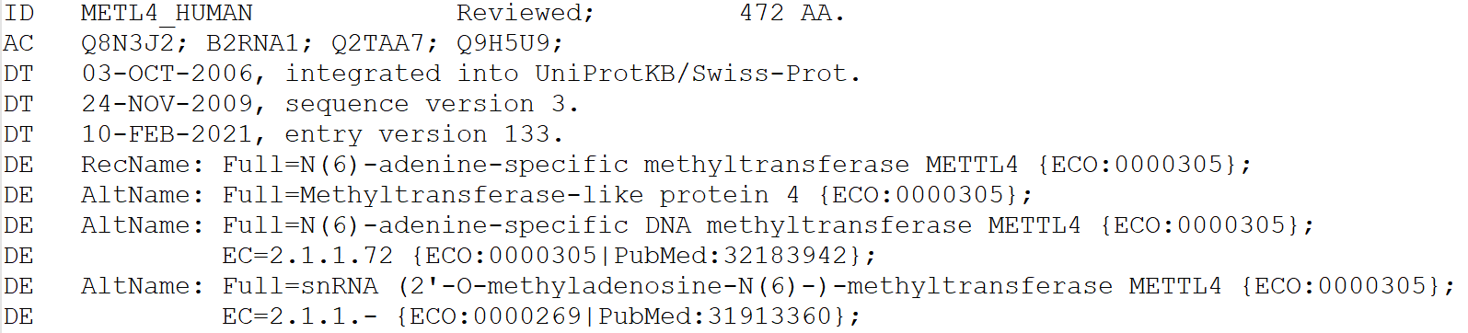
Homework 1
4個AC對到相同ID, 在資料庫只需建1筆資料 (Primary key = ID)
有2個EC 2.1.1.72, EC 2.1.1.- 都需要存到資料庫

Slide 6
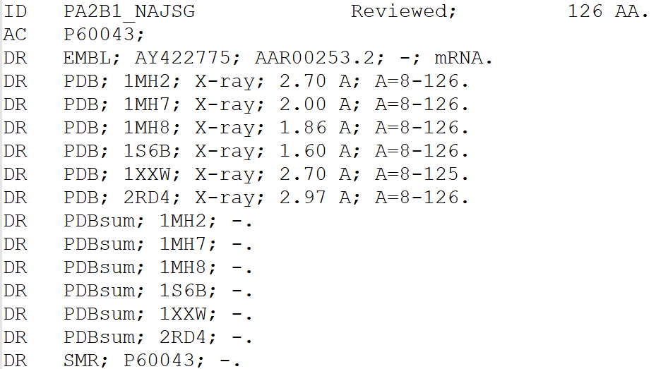
Homework 1
1個ID對到多個PDB, 在資料庫存到相同欄位, 內容以;分隔

Slide 7
Homework 1
Score
資料表建立 10%
資料庫連線 10%
分析uniprot_sprot.dat
ID 10%
AC 10%
EC 15%
PDB 15%
Sequence 15%
資料儲存正確 15%

Slide 8
Deadline
Deadline
2021/04/28 23:59
Submit
Portal
Filename
s+SID_HW1.pl
e.g : s1001234_HW1.pl

Slide 9
Q&A

